Slide 1

Add quote or statement here
- Name Last
Eco Sync

Slide 2
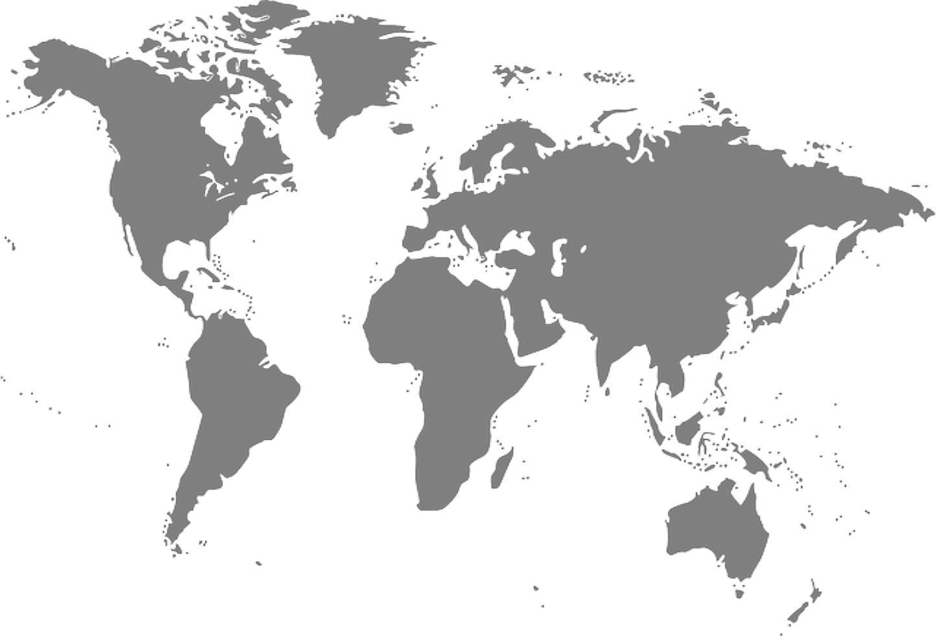

Eco-Sync – Team Intro
Kyndryl
Pedro Soares
Adrianna Kocyba-Kostecka
Amani Gaddamedi
Praveen Kumar Madhava Rao
Dominika Fargasova
Sasikala Palanisamy
Chandan Bhat
Vidyasree Bharathwaj
BhavyaShree Mucherla

Slide 3
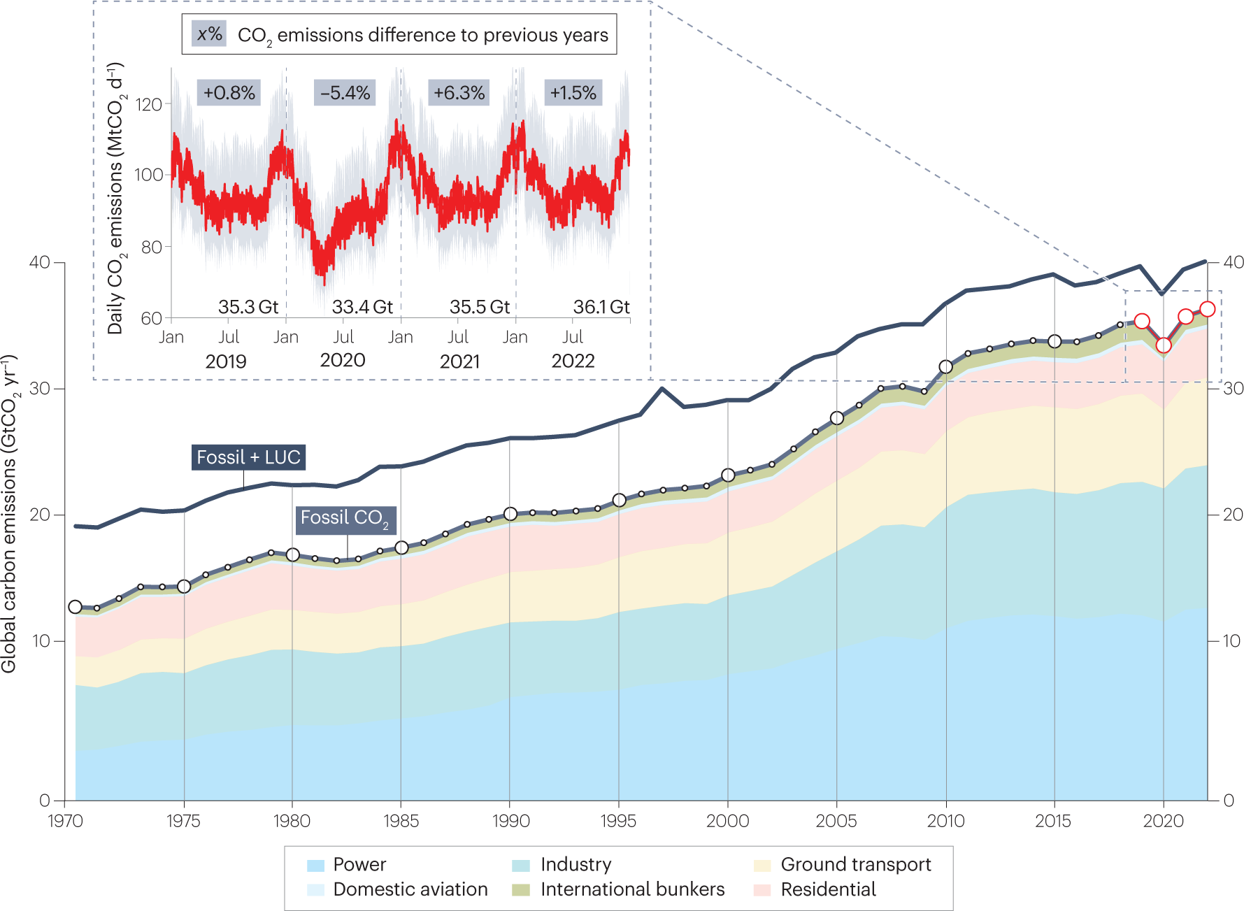
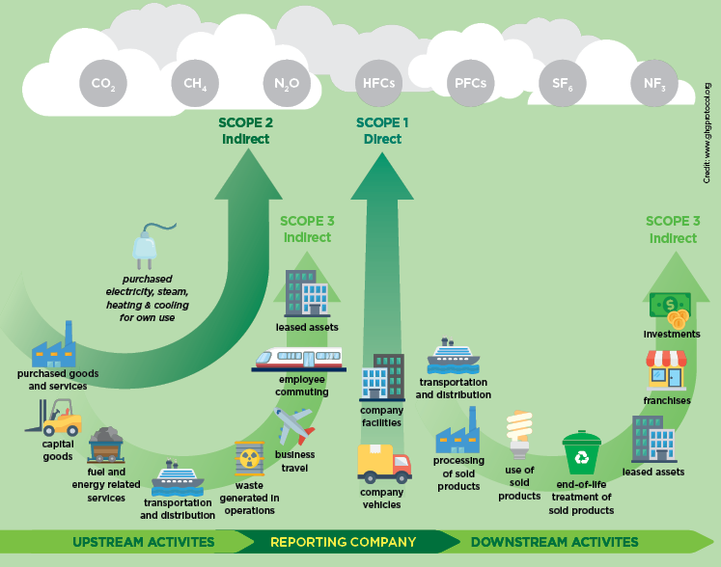
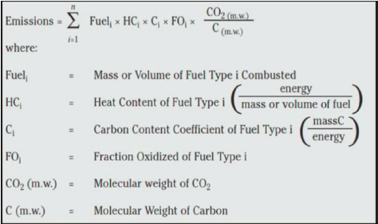
ESG and Carbon Footprint
Ref: - UCT carbon footprint report 2018 | UCT News

Slide 4
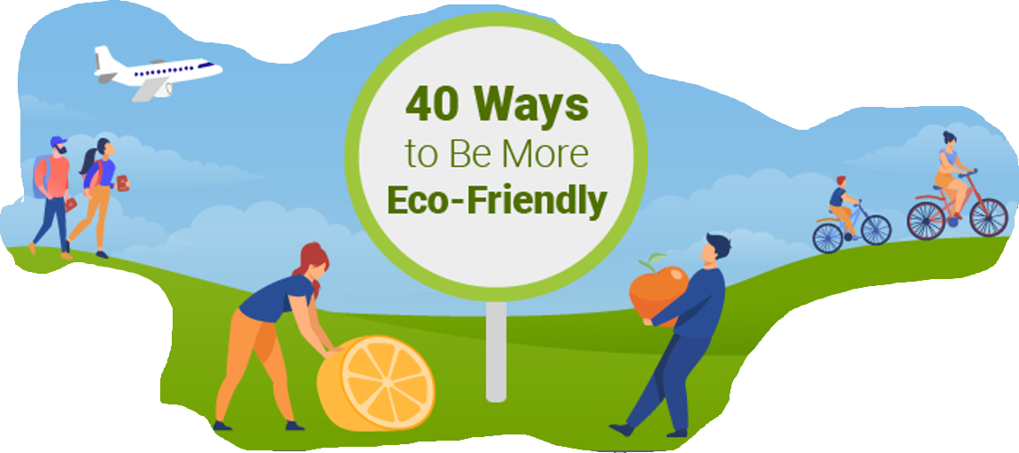



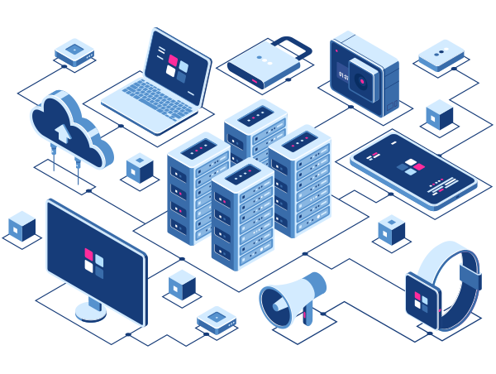
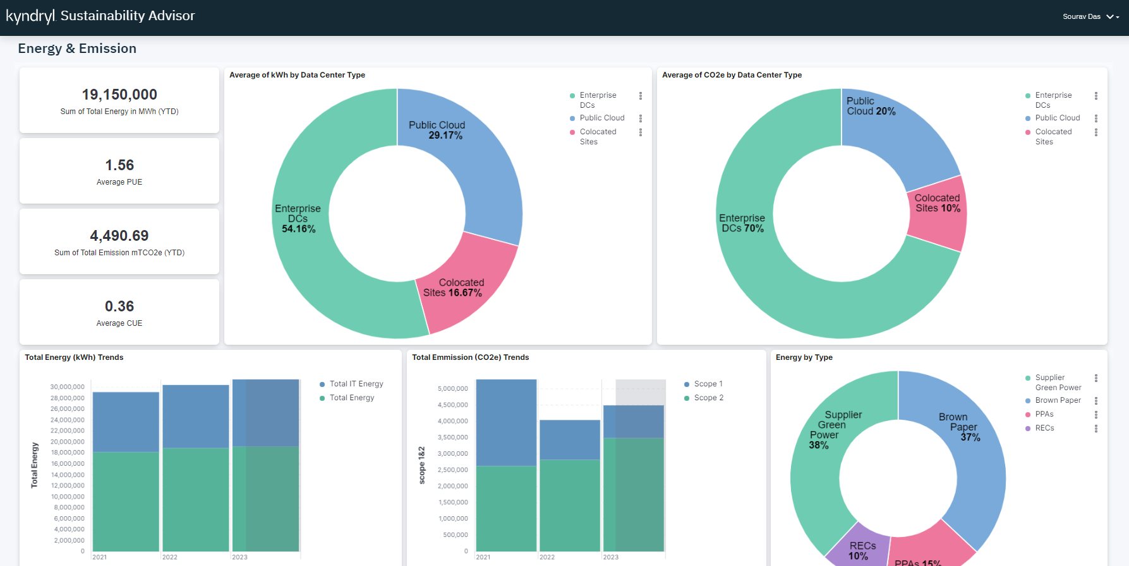
Helps with ESG Score for Individuals / Employees
Eco-Sync – An Overview
ECO-Sync
?????
How am I Environmentally/ Socially responsible ??
Sustainability Advisor
Green IT & Sustainability
Collect/ Measure sustainability Metrics
Energy usage
GHG emission
Water usage, etc.,
Provide Sustainability Reports
Analyze
and recommend

Slide 5
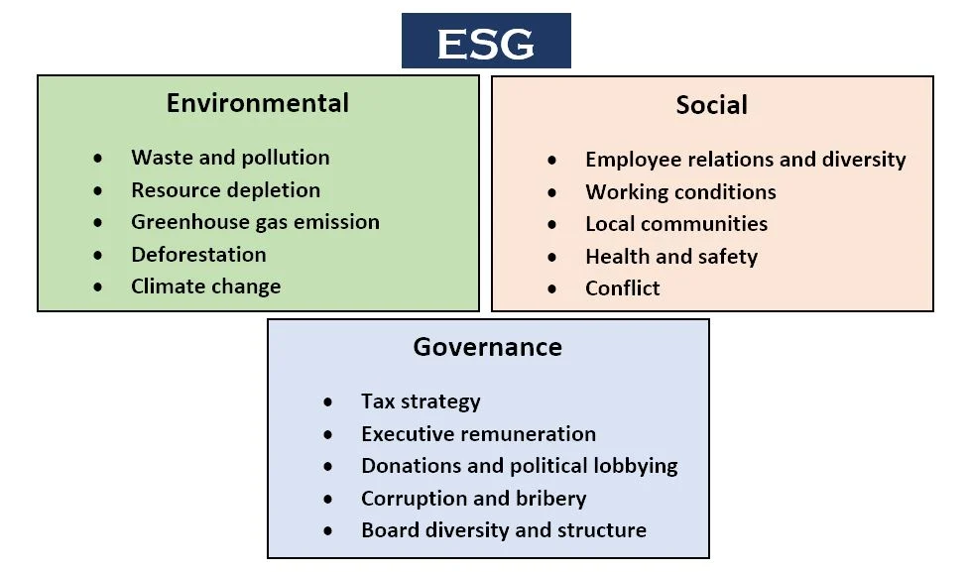
Eco-Sync
GreenSpark Theme 2:
A common Plug & Play framework that collects the ESG metrics
→ from multi-varied technological and business environment
→ to provide the ESG report, Predictive insights and
implementable advice to enhance ESG investment / Score.
A common pluggable framework to be able to pull the ESG information from different 3rd party technologies ( VMware, hyperscalers, etc..) into common data lake ( Bridge) and make it available for insights.
Problem Statement:
ESG Metrics (Environmental, Social & Governance)
Data Privacy
Data Ownership
Potential Misuse
Hence willingness to share data
Eco-Sync :
Self-Sovereign Identity (SSI)
Granular control over their data
Enriched Trust & Transparency
AI Powered Anonymization
k-anonymity
Differential privacy
Immutable Data transaction
BlockChain
Homomorphic encryption

Slide 6


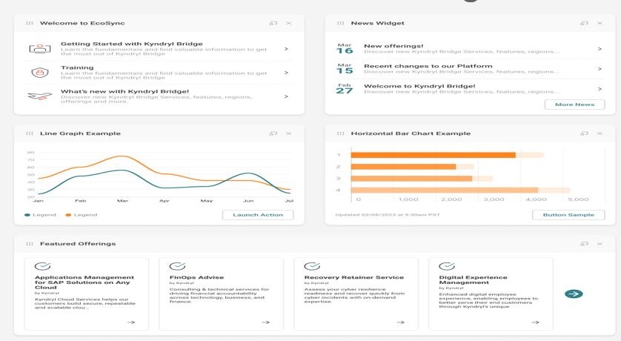





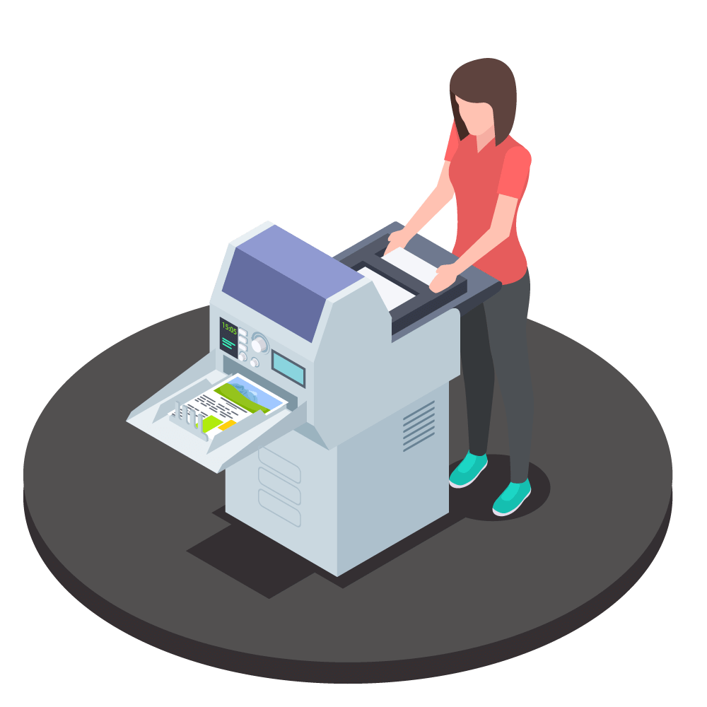


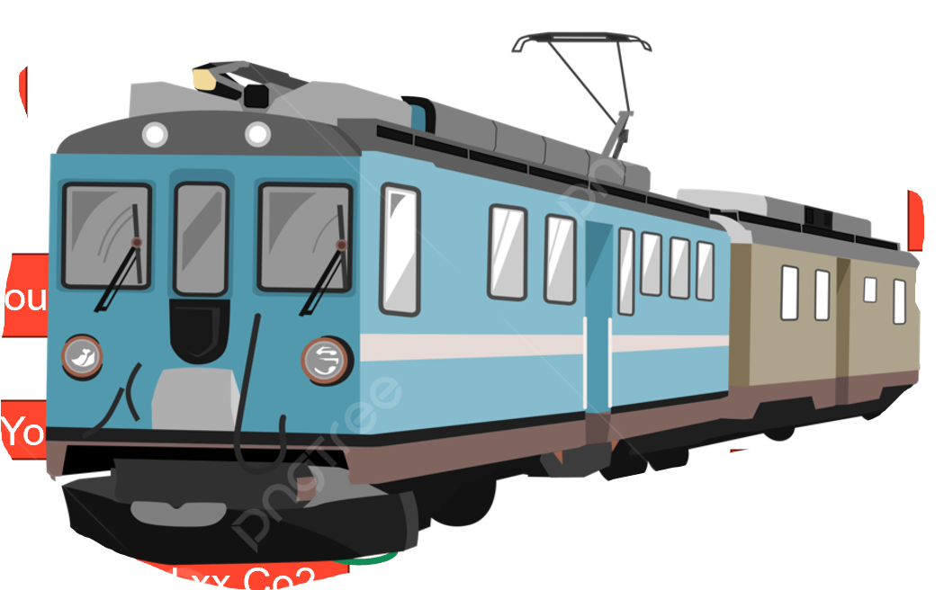


Collective contribution towards Net-Zero Statement (Save Earth)
For the Enterprise to achieve Goal of Net-Zero
Enterprise Organizations motivates their Employees to support Net-Zero Goal
Recognize Green Stars
Reward Points
Recognitions
Badges
Eco-Sync
Organization’s Dashboard
You saved xx Co2
Eco-buddy
Eco-Sync Provides Implementable Advice to enhance and Optimize the Organizations ESG Score
1. Overall Org’s ESG Score
2. Individual Employees ESG Score
3. Top 10 Contributions for Net-Zero Goal
Eco-buddy
You Contributed xx Co2
Eco-buddy
You saved xx Co2
Eco-buddy
You saved xx Co2

Slide 7



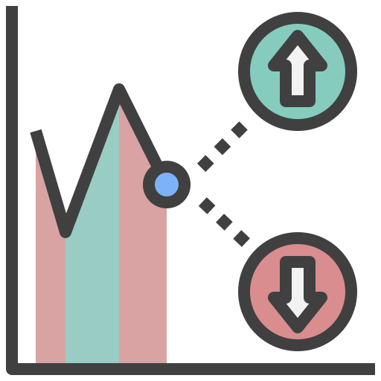


Highlights
Eco-Sync Architecture Overview
Wide Range of Technologies
Quantitative ESG Metrics
Sustainability Advisor
Various hosting Platforms
Empowered Individuals: Individuals like Anna control their data and choose what they share, fostering trust and participation in ESG initiatives.
Enhanced Data Security: AI-powered anonymization techniques minimize the risk of data breaches and misuse.
Improved Transparency: Clear audit trails and granular access controls ensure transparency in data handling practices.
Richer ESG Data Insights: Anonymized data from various sources empowers companies to gain deeper insights into their ESG performance and identify opportunities for improvement.
Anonymized thro k-anonymity
Immutable Txn thro Blockchain
Usage patterns / Utilization trends
Cognitive Load Manager
Eco-Sync Data Collection Framework
Data Aggregation & Correlation
Analytic Engine
Choice of Ent Apps
Various Industry Verticals
Insights & Predictions
Data Pipeline
ESG Indicators
Metric Library
Empowered by
Self-Sovereign Identity (SSI)
Eco-Buddy
Policy Engine
(Granular access Control, ESG Tagging & Data Transformation)
AI/ML
Insights with ESG report
Predictive Insights & advise
Metric Advisor
Non-technical/Non-Financial Metrics
Data Protection thro Differential Privacy
Secured Txn Homomorphic Encryption
Precise advice thro Federated Learning
Non-Tech Environmental metrics (Resource Depletion / GHG emission)
Social metrics (Diversity, Inclusion, Health & Safety )
IT Monitoring with Eco-Sync
Qualitative ESG Metrics
Customer1 Banking Industry
Customer2 Retail Industry
Customer2 Energy Sector
…
Customer n
XYZ Industry
Governance metrics (Ethics & Compliance)
7

Slide 8

Eco Sync – Theme 2
Business Value
Eco-Sync add value to Kyndryl to help our customers enrich their ESG score, providing them the insights and recommendation thus making customer’s business more sustainable.
Novelty
Eco-Sync seamlessly collects in ESG metrics from various third-party tools & technologies, unify the data for analysis and generates insights and recommendations.
Self-Sovereign identity (SSI) –
A digital Wallet enabled with distributed data storage and better data control thro Granular access permissions.
K-anonymity:
A sophisticated anonymization techniques that masks/removes personally identifiable information while preserving the data's statistical value for ESG analysis.
Feasibility
Eco-Buddy →
Collects ESG metrics from various third-party technologies via SSI Digital Wallet. This includes granular ESG tagging and access control.
Cognitive Load Manager → Performs AI powered data aggregation, correlation and analysis embracing various metrics/indicators/diverse environmental factors and made it available in Metric Library
Metric advisor →
Delivers constructive recommendations, standard insights and custom insights based on chosen indicator
Highlights
Self-Sovereign Identity
K-anonymity
Differential privacy
Homomorphic Encryption
Secured and decentralized data sharing with more granular control
Immutable data processing using Blockchain

Slide 9
Working Demo
Date

Slide 10
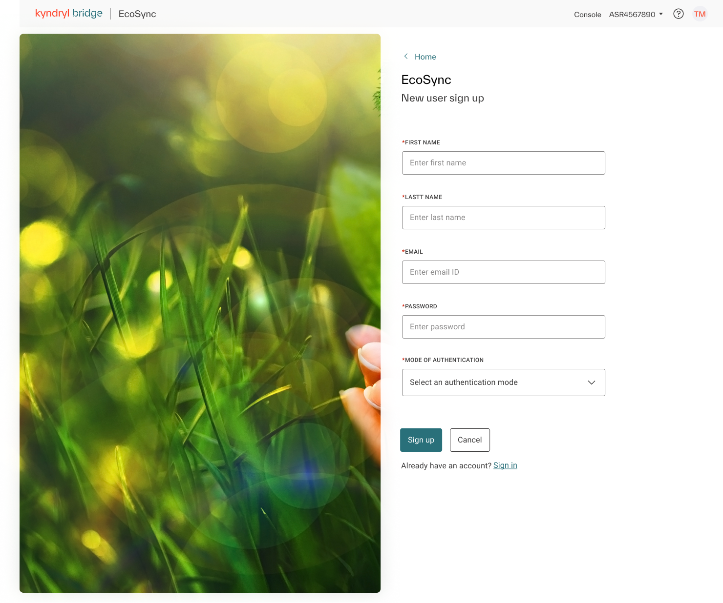
Eco-Buddy : End User Registration
Highlights
Lightweight App compatible for Mobile, Tab, Laptop and Desktop
Trusted Digital Wallet where user can have a granular control on data sharing to third-party apps

Slide 11
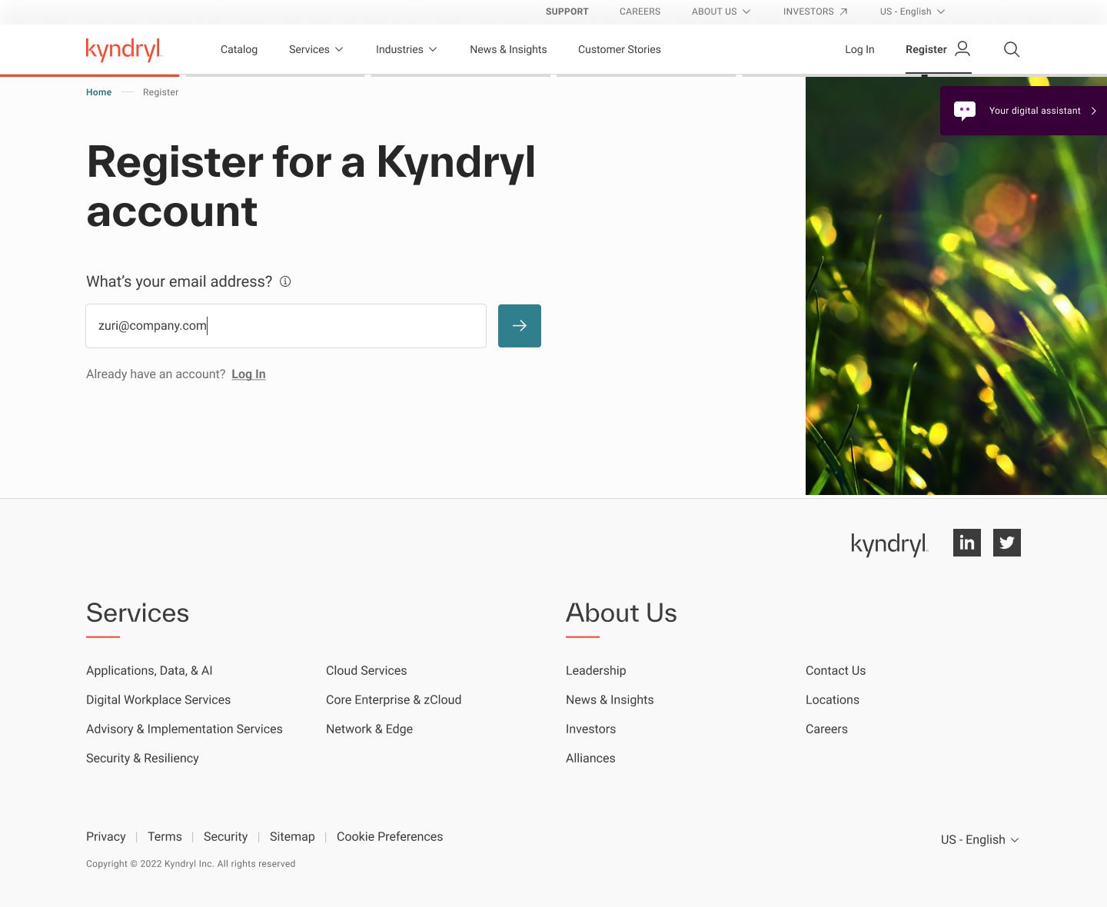
Eco-Buddy : Employee Registration through SSO

Slide 12
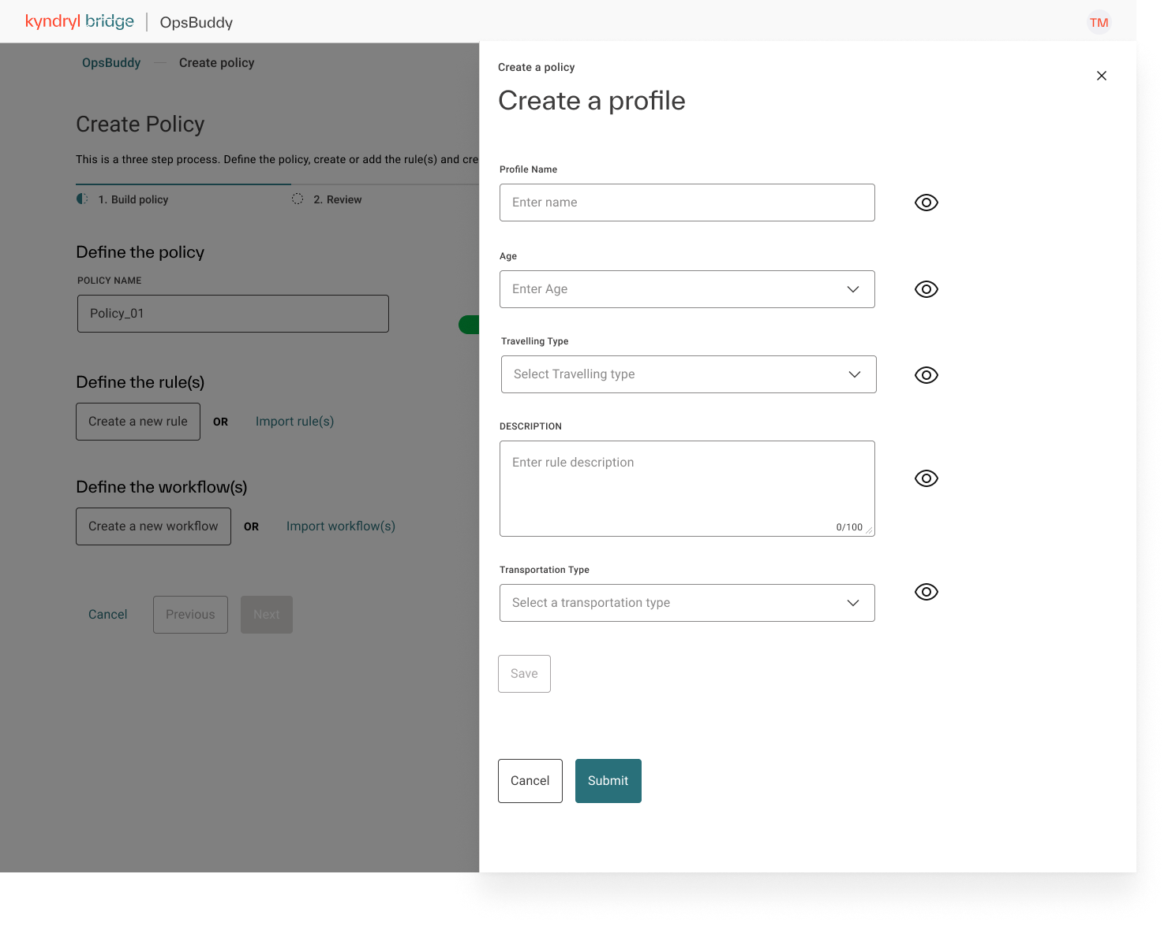
Eco-Buddy : User Profile Setup

Slide 13

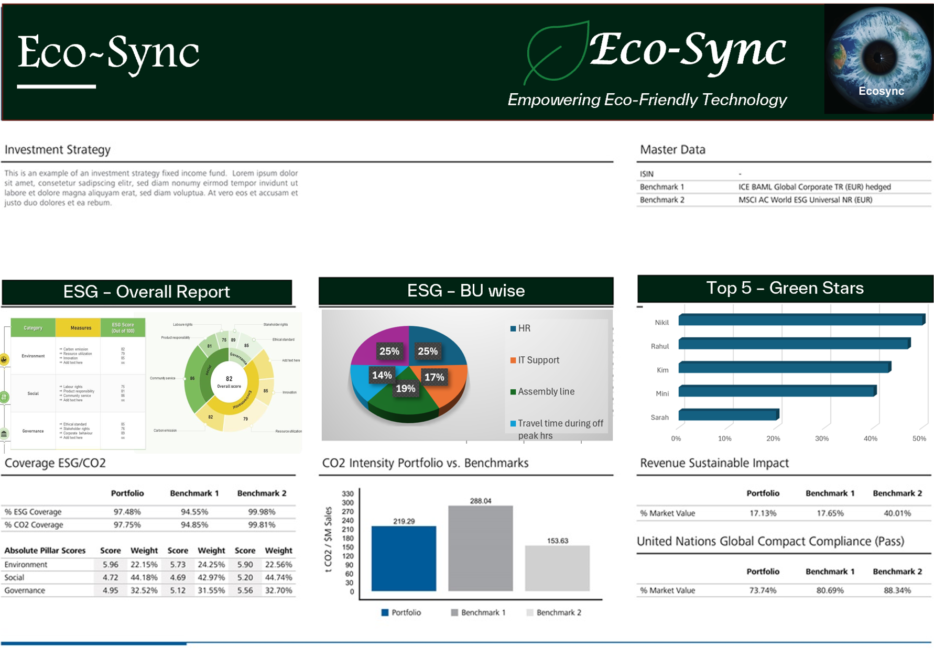


Eco-Buddy : Sample ESG Report

Slide 14
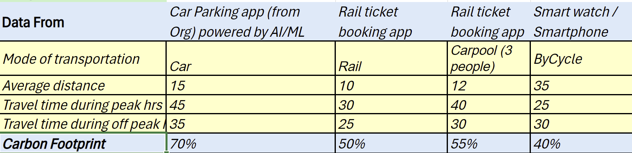
Eco-Buddy : Sample / Anonymized data

Slide 15
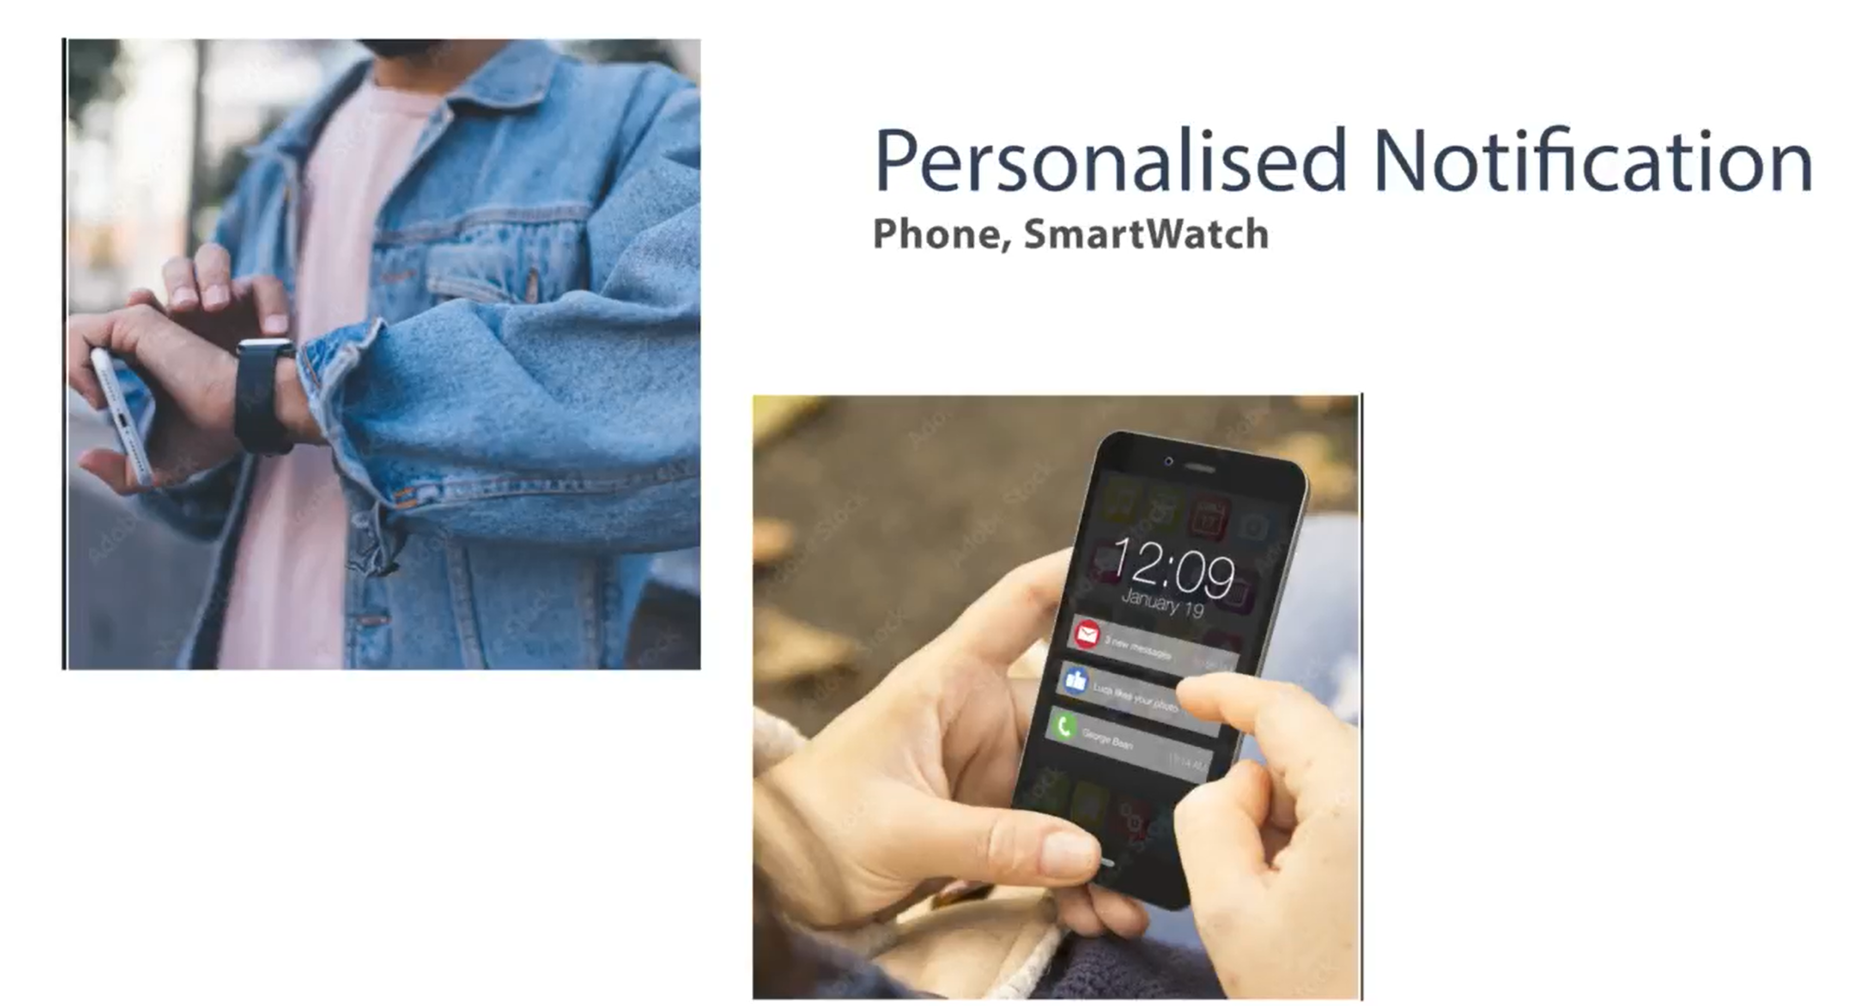
Eco-Buddy : Sample Personalized proactive Recommendations
Why can't you think about Cycling to work Today as the Climatic condition is so pleasant and would help contribute more to Save Earth and also reach your fitness target
Today Is a hot and sunny day. You could conserve Electrical energy by hand drying your cloths rather using dryers

Slide 16
Thank You
Date

Slide 17
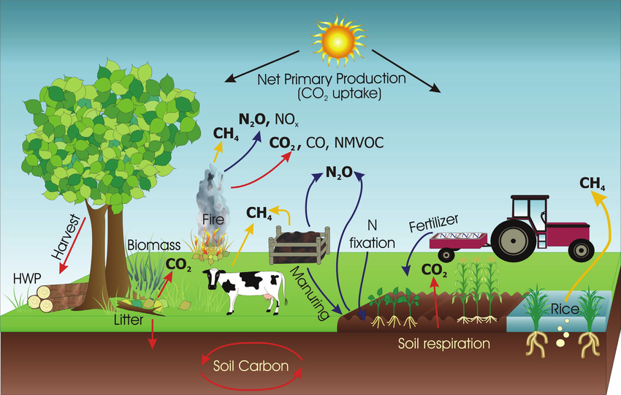
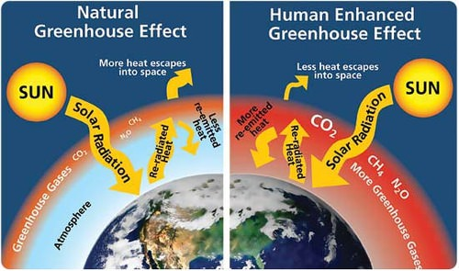
Global CO₂ emissions in 2022
Carbon Emission
– Calculation
Ref: https://www.researchgate.net/
https://flexbooks.ck12.org/

Slide 18
Eco-Sync – Theme 2
New skills
Block chain technology
Machine Learning
Data Security (Data Privacy / Sovereignty / Homomorphic Encryption)
OnDemand Custom Indicator based Insights
Team Work
Team formed with the diverse skills that includes, Architecture & Design, Visual Innovation, Governance etc.,
1. Adrianna Kocyba-Kostecka
Governance
2. Sasikala Palanisamy
Design Lead
3. Amani Gaddamedi
Design Architect
4. Vidyasree Bharathwaj
Backup Design Lead
5. Chandan Bhat
Visual Innovation Lead
6. Pedro Soares
Review & Advancement
7. BhavyaShree Mucherla
Visual innovation lead
8. Dominika Fargasova
Visual innovator
9. Praveen Kumar Madhava Rao
Visual Innovation Lead
Highlights

Slide 19
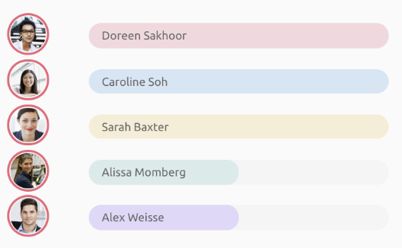
Eco-Buddy : Sample ESG Report
GoGreen Stars (Jan-24)

